Slide 1
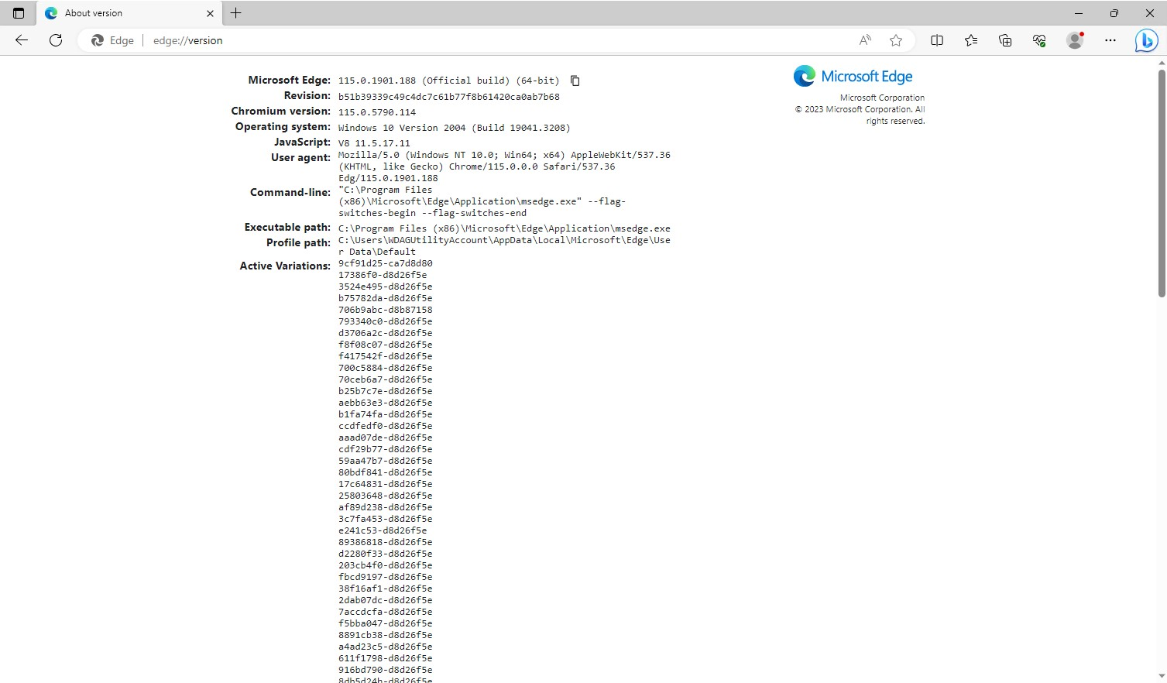

Slide 2



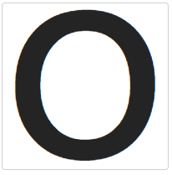
Last moves:
X1
O6
Players:
Player A (X)
Player B (O)
+0.0

Slide 3




